Slide 1
Targeting Flu Vaccine Outreach with Predictive Analytics
Using Machine Learning to Reach the People Who Need Us Most

Slide 2
Problem Statement
Current Situation:
CDC runs nationwide flu vaccination campaigns every year
We spend millions on outreach (ads, mailers, community events)
But vaccination rates remain below public health targets
The Problem:
Right now, we use a broadcast approach. This means:
  Mail flyers to people who already got vaccinated
  Money on people who don't need convincing
  Never reach the people who are actually hesitant
  Lower return on investment
The Question:
What if we could predict ,exactly which individuals are unlikely to get vaccinated? Then target only them.

Slide 3
What We Did
We built a system that identifies non-vaccinators with 95% accuracy.
Using CDC survey data from 26,707 Americans, we created two prediction models:
Model 1: Seasonal Flu
Predicts who will skip the annual flu shot
Baseline model—reliable, interpretable
Model 2: H1N1 (Pandemic Flu)
Predicts who skipped the swine flu vaccine in 2009
Captures how people behave during health emergencies
Both models answer one question: Who should we reach out to?

Slide 4
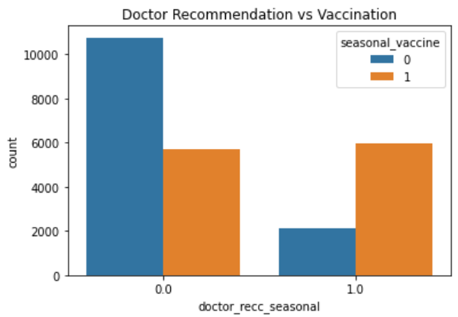
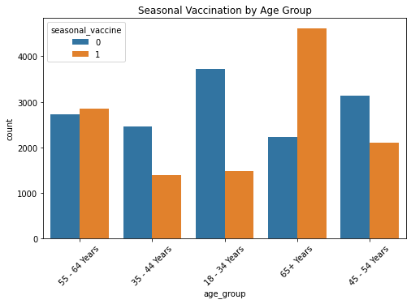
Our Most Important Finding
When a doctor recommends: Vaccination rates TRIPLE
When no recommendation: Most people skip the vaccine
Implication: Best intervention isn't patient-facing. It's provider-facing.

Slide 5
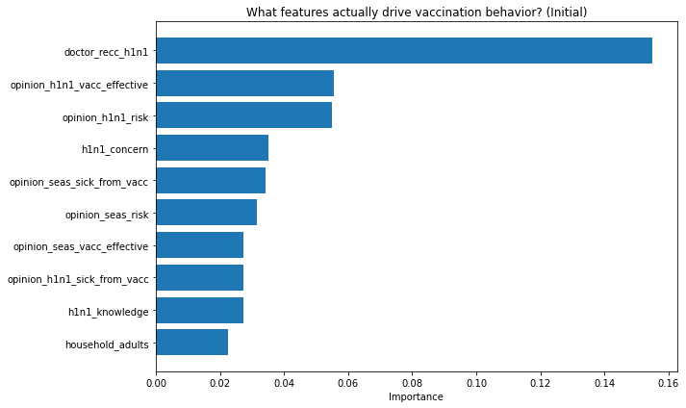
What Actually Predicts Non-Vaccination?
Doctor recommendation is top because patients trust their own physician more than any campaign, a 3-minute conversation is worth 1,000 flyers.
Belief in vaccine effectiveness and perceived personal risk are next; people skip shots they think don't work or don't need.
Income, education, and region barely matter—hesitancy crosses class lines and geography. This isn't about who people are or where they live.

Slide 6
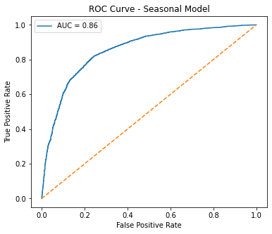
Model Performance
Seasonal flu: Identify 82% of non-vaccinators
H1N1 (tuned): Identify 95% of non-vaccinators
Out of 100 people who won't vaccinate:
- We correctly flag 95
- We miss only 5
False negatives (missed opportunities):
Reduced by 70% from baseline

Slide 7
Cost Impact & Recommendations
Current model: Contact 100% of households
Our model: Contact top 30% highest-risk
Capture: 95% of actual non-vaccinators
Result: Reduce outreach costs by 60-70%
Three recommendations:
1. TIER OUTREACH BY RISK
High (0.7-1.0): Direct contact
Medium (0.4-0.6): Digital
Low (0.0-0.3): Awareness only
2. SEGMENT BY AGE
Young adults: Workplace clinics
Middle-aged: Family protection
Seniors: Maintain access
3. INVEST IN PROVIDERS
One-page MD guides
EHR prompts
Incentives for high-recommendation clinics

